Slide 1
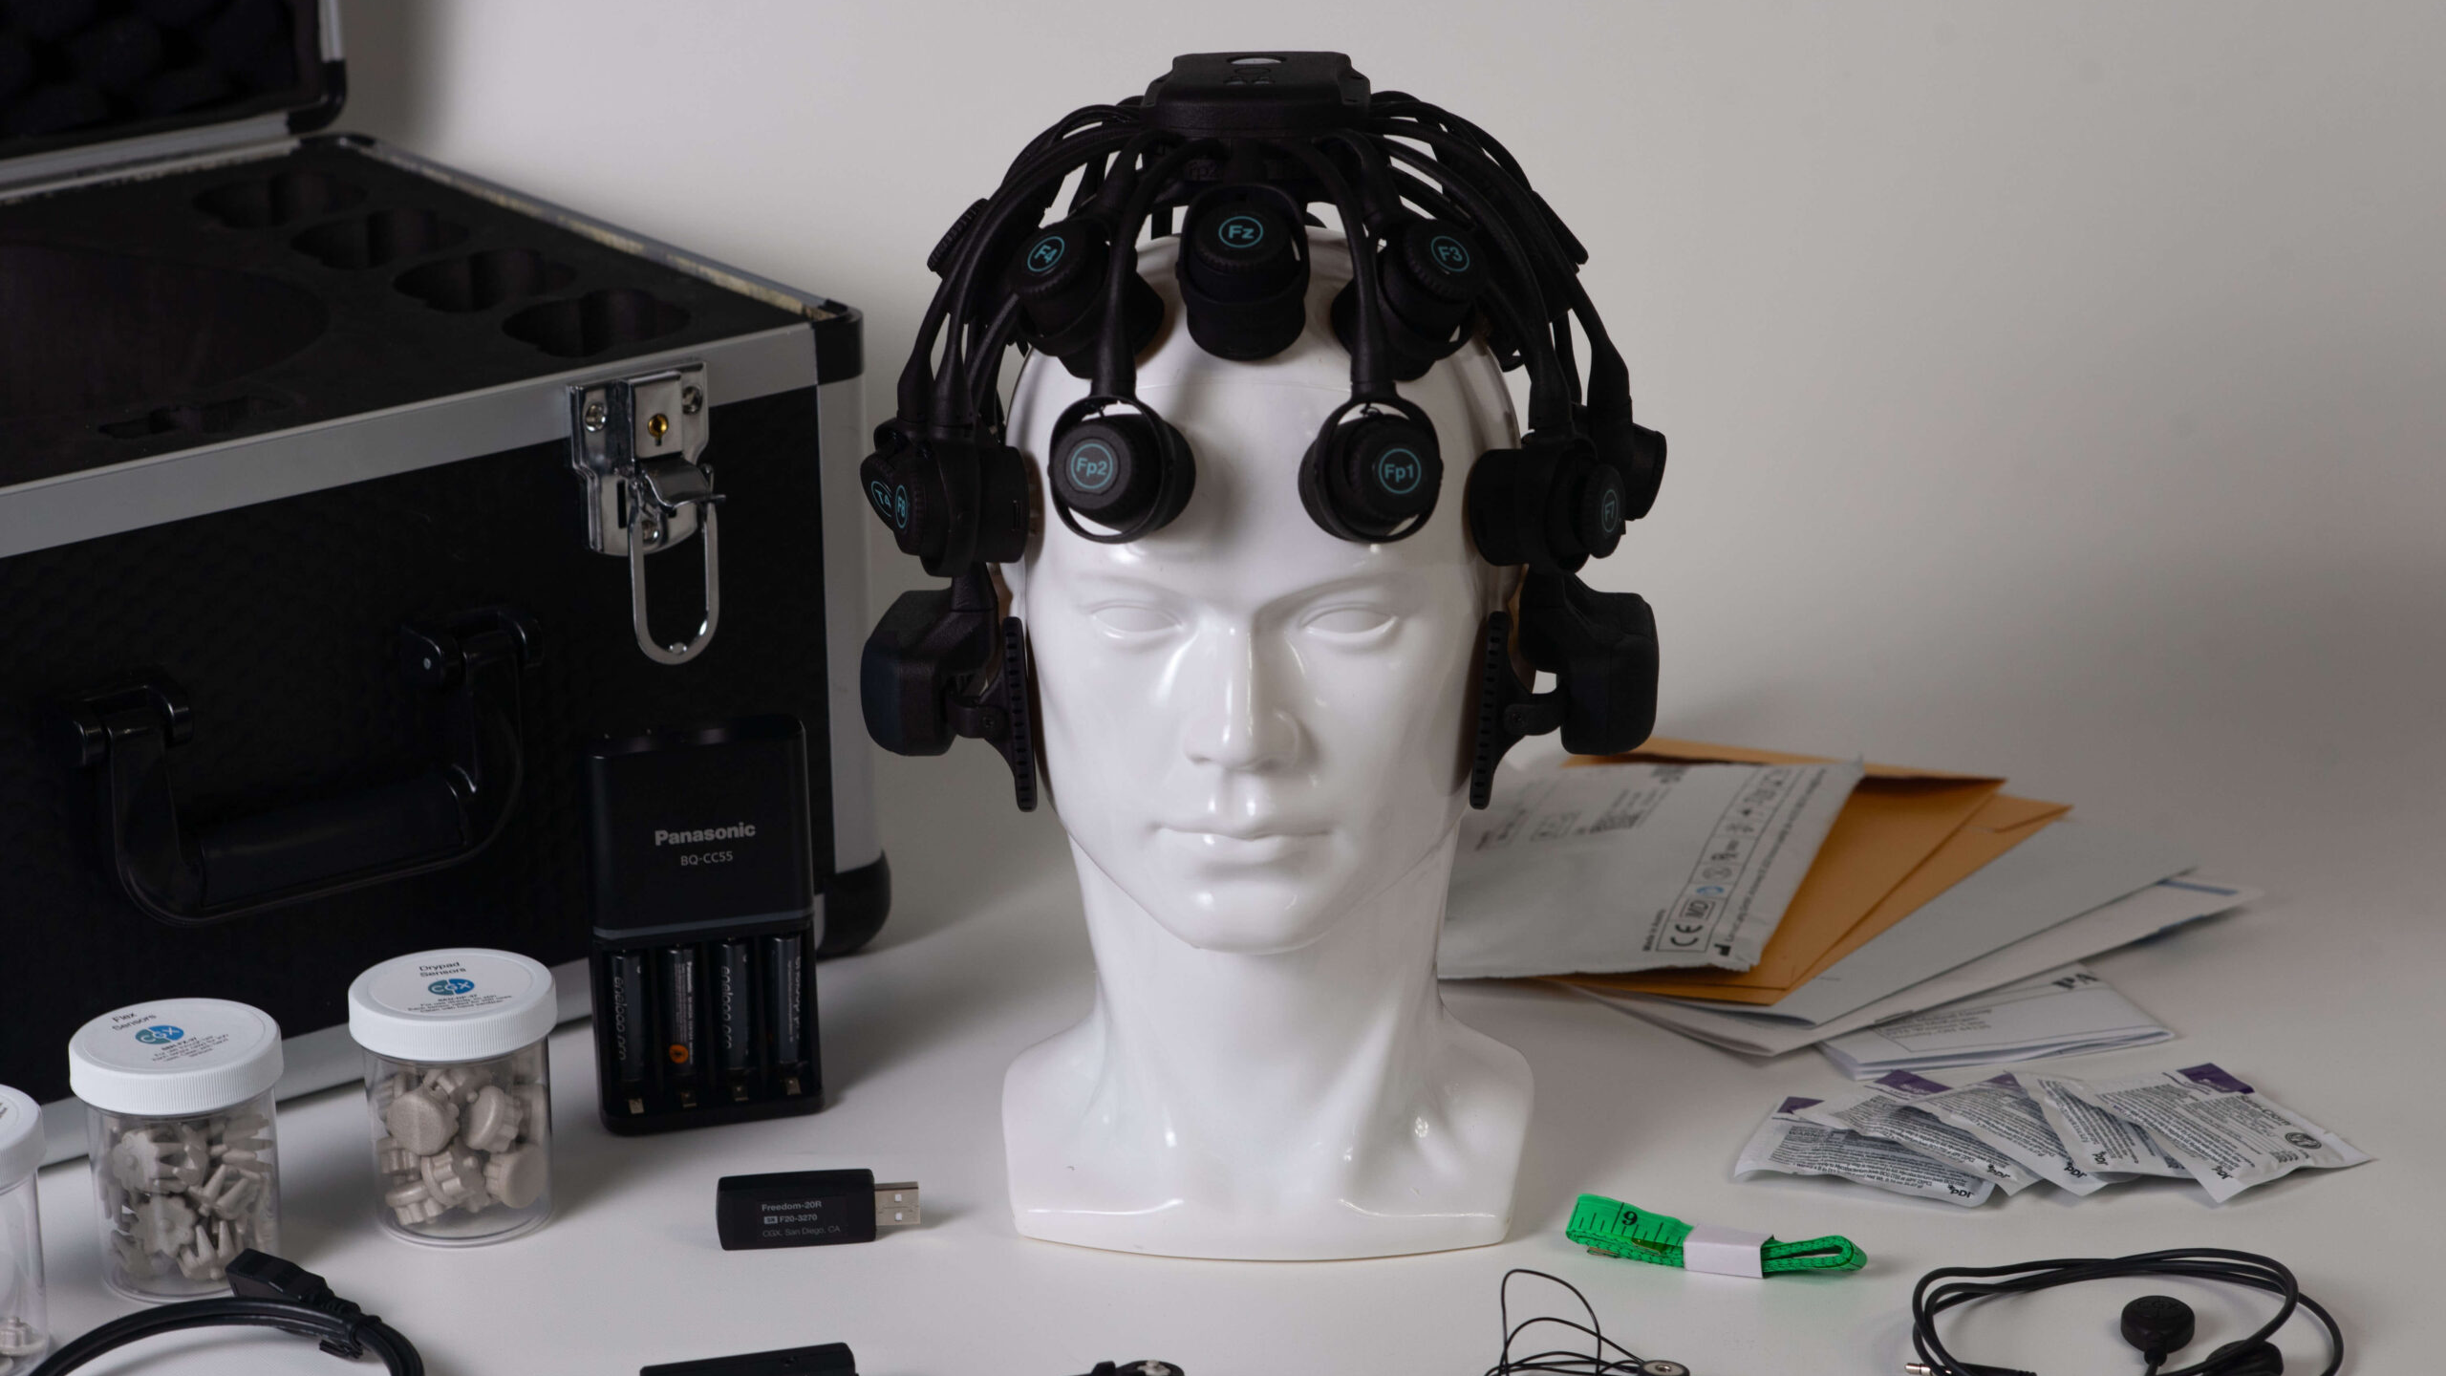
AI-Driven Depression Severity Classification
A Machine-Learning Framework for Eyes-Closed EEG Analysis
Shereen Shaban Mahmoud Hamed
AYAIR 2026

Slide 2

Research Overview
The Challenge:
Adolescent Depression
Global Urgency: Mental health in adolescence is a
critical priority.
Diagnostic Limitations: Address the need for
objective innovation.
Research Motivation: Investigate whether EEG-
derived features can support depression-severity
classification.

Slide 3
The Signal: Why EEG?
Utility
  EEG is a non-invasive physiological measurement that may
  provide useful research features.
Resting-State Dynamics
  Captures intrinsic neural oscillations.
Protocol Standardization
  The eyes-closed protocol provides a standardized resting
  condition and may reduce task-related variability.

Slide 4

Project Overview
Research Goal:
Decision-Support Framework
Primary Objective
Develop a research framework for three-class depression-
severity classification.
Clinical Philosophy
Designed as a future-facing decision-support application.
Implementation Caveat
Deployment is strictly subject to rigorous external clinical
validation.

Slide 5
Data Overview
Dataset derived from the Rachamanee & Wongupparaj (2021) study
Total Participants
Feature Density
85
600
Includes processed EEG-derived
spectral features.
features per participant

Slide 6





Reproducible Pipeline Workflow
A structured approach to EEG data processing and analysis
Data Acquisition
Preprocessing
Feature
Selection
Classification
Validation
Integration of raw
EEG metadata.
Data quality checks
and participant-level
reshaping of
processed EEG-
derived features.
Statistical filtering
using ANOVA.
Multi-class machine
learning training.
Performance
verification via
stratified participant-
level splits.
This workflow ensures systematic and reliable EEG data processing from acquisition to final validation.

Slide 7

Design Integrity & Data Leakage Prevention
Isolation Principle
Training Integrity
Test Set Security
Strict pipeline isolation.
Preprocessing and feature selection
calculated within the training fold.
The hold-out set remains unseen until
final assessment.

Slide 8



Exploratory Data Analysis (EDA)
Data Cleaning
Structural Transformation
Statistical Mapping
Systematic inspection of missing values
and feature-level outliers.
Reshaping high-dimensional feature
vectors.
Correlation matrices to detect multi-
collinearity.

Slide 9
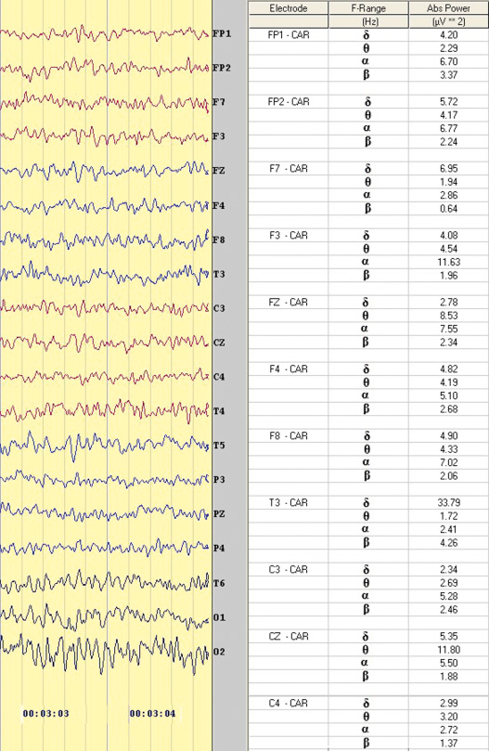
Approach Details
Modeling Methodology
Feature Matrix (X): Constructed from processed EEG spectral metrics.
Target (y): 3-class severity scheme.
Stratification: Participant-level split with 68 training and 17 held-out
participants.

Slide 10

Exclusion Criteria & Leakage Control
Data processing and feature integrity measures for predictive modeling
Input Feature Constraints
  Focus on processed EEG features.
Data Sanitation & Privacy
  Identifiers and demographic variables were excluded from predictive
  features; Group was retained only as target y.
Prevention of Target Leakage
  Exclusion of BDI-II and PHQ-9 scores from independent variables.

Slide 11


Evaluation Design
Training and Evaluation Framework
Training Set (68)
Held-Out Test Set (17)
Used for 5-fold cross-validation and hyperparameter
optimization.
Used as the primary held-out evaluation on unseen participants
from the same dataset.

Slide 12


Metrics for Success
Performance evaluation across class categories
Balanced Accuracy
Macro-F1 Score
These metrics provide a balanced assessment across the three severity classes; interpretation should remain cautious because of the small sample size.
64.4%
63.8%
These metrics ensure a more balanced assessment across classes.

Slide 13
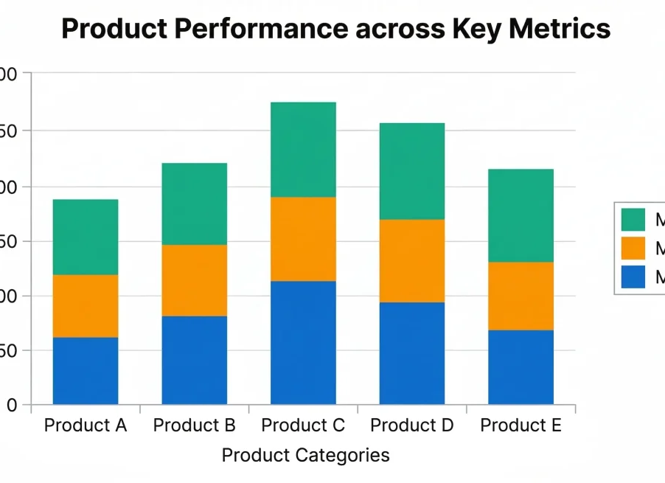
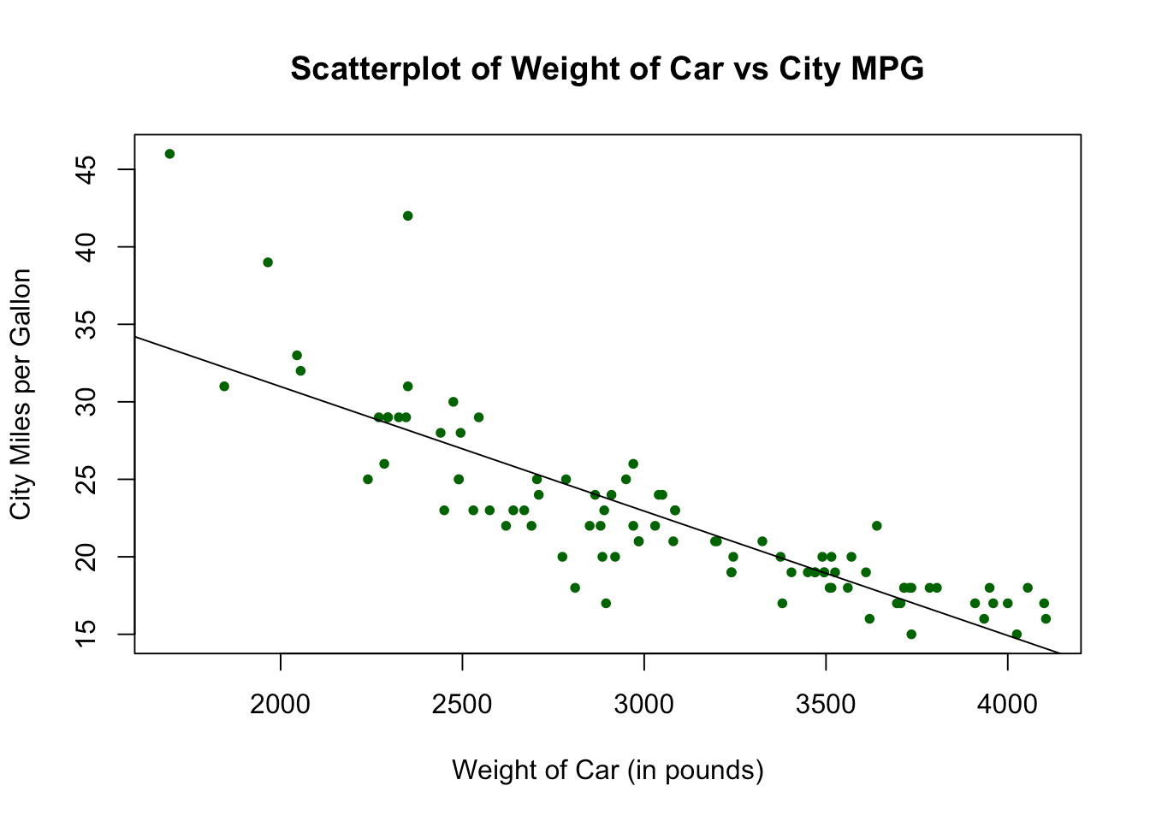
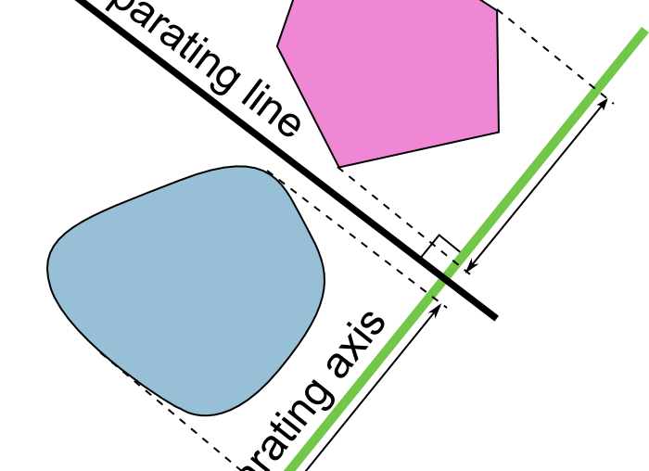
Baseline Models Comparison
Evaluation of performance and characteristics
Extra Trees
Logistic Regression
SVM
Strongest baseline performance.
Linear baseline.
Non-linear comparison for high-
dimensional spaces.

Slide 14



Tuning the Extra Trees Model
Model optimization parameters and feature selection settings
Ensemble Size
Feature Strategy
Parameter Optimization
Selected 300 trees during hyperparameter
tuning.
Top 100 features using ANOVA F-score.
Fine-tuning min_samples_leaf.

Slide 15


Rigorous Selection Protocol
Cross-Validation
Statistical Integrity
Stability Assessment
5-Fold Stratified approach.
Preserving target distribution.
Used to quantify performance
variability and reduce selection bias.

Slide 16
Held-Out Test Classification Metrics
Performance analysis of participant classification
Accuracy
Macro-F1 Score
64.7
63.8
Accuracy
Macro-F1 Score
Balanced Accuracy
64.4
Patient Classification
11 out of 17 participants correctly classified
Balanced Accuracy

Slide 17
Performance Overview
Class-Wise Performance Analysis
Performance fluctuations were detected across categories.
Interpretation of results should be cautious due to the limited sample size.

Slide 18
Understanding Uncertainty & Sensitivity
Stability and Variance Analysis in Neuro-imaging Research
Repeated Cross-Validation Stability
Repeated Cross-Validation Deviation
0.521
Interpretation
11.3%
Performance varied across repeated splits, reflecting sensitivity to individual participants in this small dataset.
Mean Repeated-CV Balanced Accuracy
Interpretation: Repeated-CV variability should be considered when assessing model reliability.

Slide 19
Transparency in Revision
Evolution of our pipeline and reproducibility standards
Manual/Legacy
Integrated/Modular
Fragmented pipeline processes
Heavy reliance on manual intervention
High susceptibility to human error in
calculations
Transitioned to an integrated, modular
pipeline
Automated preprocessing workflows
Reduced manual intervention in
calculations for improved reproducibility
By shifting to a modular and automated approach, we have significantly
increased transparency and reliability across our revision processes.

Slide 20


Limitations and Realism
Sample Size Constraints
Generalization Challenges
The dataset contains 85 participants, with 68
used for training, limiting statistical power and
generalizability.
Broader validation is required.

Slide 21

Summary
Conclusion: The Path Forward
Proof of Concept: EEG-derived features show
potential for modeling depression severity.
Vision: Foundational architecture for future clinical
research integration.
EEG-derived features offer a promising foundation for future clinical depression severity modeling.

Slide 22



Future Research Directions
Strategic roadmap for advancing EEG research and model reliability.
Research Development Pillars
Scale
Validation
Explainability
Expand cohort size and diversity to
enhance generalizability.
Conduct multi-site external testing to
ensure robust performance.
Use interpretable EEG feature analysis
to improve trust and transparency.

Slide 23

References
Rachamanee, S., & Wongupparaj, P. (2021). Resting-state EEG datasets of adolescents with mild, minimal, and moderate depression. BMC Research Notes, 14, 256. https://doi.org/10.1186/s13104-021-05673-x
OSF DOI: 10.17605/OSF.IO/4HQ3Y

